Slide 1
Make Pitman Hall Zero Emission Building
February 21, 2024
Presented by:
Hafsa Siraj
Kavita Verma
Indu Jyoti Das

Slide 2
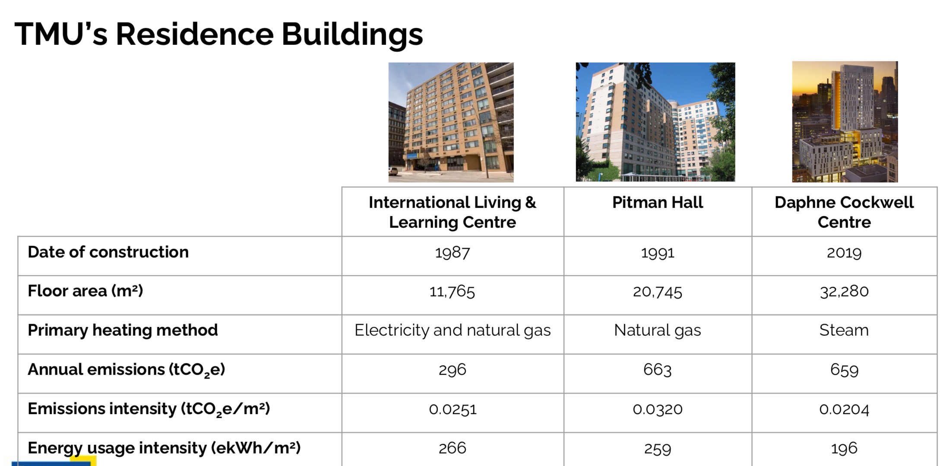
What’s the Problem ?
Why Pitman Hall?

Slide 3
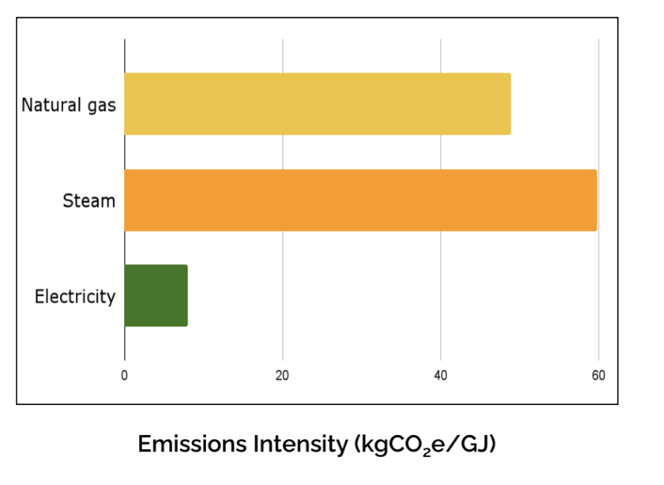
Highest Carbon Footprint
Why such a High Carbon Footprint?
Dependency on Natural Gas as main source
Built in 1990’s- so the infrastructure is outdated
Poor Thermal Envelope

Slide 4
How do we Solve this?
Principles of Net Zero Design
Energy Conservation | Energy Efficiency | Renewable Energy Source
Grey Water system implementation | Installing LED and motion sensor lights and faucets | Use unwanted heat from chiller plant
Setting Programmable thermostats | Upgrading Thermal Envelope | Photovoltaic panels

Slide 5
Solution / Feasibility
The technology is available however not widely adaptable in Canada. This technology demands geothermal expertise.
We have designed our solution so that it is practical , cost-effective and doesn’t affect day- day activities within the building.
Challenges:
Intermittency of Renewable Energy: Requires solutions for storage and distribution.
Infrastructure Upgrades: Transition may demand substantial infrastructure improvements.

Slide 6
Costs Analysis
New Addition | Quantity | Cost per item | Cost ($) estimate including installation fees
Greywater | 567 | 500 | 328,800
Motion Sensor Lights | 100 | $30 | 35,000
LED Lights | 567 | $5 | 2,835
Programmable Thermostat | 56 | $30 | 4,480
PV solar panels with storage | 40 | $275 | 51,000
Bore holes/heat pumps | - | - | 365,000
Three pane window | 567 | $500 | 283,500

Slide 7
Competitive Analysis
New Addition | How much we’re saving annually?
Greywater | $30,000
Motion Sensor Lights | $56,435
Thermo Stats | $40,000
PV solar panels with storage | $3,442,661
Bore holes/heat pumps | $130,000
Triple Pane Windows | $20000
Total Savings | $3683096

Slide 8
Thank you!!

Slide 9
Appendix
Gray water cost: Labour cost: 75-150/hour for plumbing a rough estimate would be 50,000-200,000. Equipment: simple systems cost between 500$-1000$
For residence of 567 rooms it would be approximately (567*500) =283,500 and adding labor costs would be about (500 hours*75)=37,500
Total=321,000
The time and cost of labor changes depending on number of workers, experience level, accessibility, etc
Maintenance cost would be
Regular Inspections: 1-2 hours per inspection, conducted monthly to quarterly. Let's estimate 2 hours per month.
Cleaning Filters and Screens: 2-4 hours per cleaning, done quarterly to semi-annually. Let's estimate 4 hours per quarter.
Pump Maintenance: 2-4 hours annually.
Component Replacements: Variable, but let's allocate 8 hours annually for replacements and unexpected repairs.
So, the total estimated maintenance time per year would be:
(2 hours/month * 12 months/year) + (4 hours/quarter * 4 quarters/year) + 4 hours (pump maintenance) + 8 hours (component replacements) = 24 + 16 + 4 + 8 = 52 hours/year.
Plumbing companies usually charge 150/hour so (52*150)=7800
Total =328,800
Additional costs maybe me involved due to specific wiring etc

Slide 10
Appendix
Reduction in Water Usage: Installing a greywater system can reduce the demand for fresh water by recycling and reusing greywater for non-potable purposes. Let's assume a conservative estimate of 30% reduction in water usage due to the implementation of the greywater system.
Current Water Costs: To estimate the potential savings, we need to know the current water costs for the building. Let's assume an annual water cost of $100,000 for the 567 rooms.
Estimated Annual Savings: With a 30% reduction in water usage, the estimated annual savings would be:
Annual Water Savings = 30% of $100,000 = $30,000

Slide 11
Appendix
Motion sensor lights: 100*30= 30,000
Installation labour: 50-150$= (50*100)=5000
Total=58,350
Thermostats: $20 to $100 each=11,340
Installation labour: 50-150$=(50*56)=2,800
Additional costs may be involved due to Integration with Existing HVAC Systems.
Annual savings for triple pane window: $20000 (Estimated 20% of $100000)

Slide 12
Appendix
Motion sensor lights:
Reduction in Electricity Usage: We'll continue to assume a conservative estimate of a 50% reduction in electricity usage for lighting due to the implementation of motion sensor lights in the hallways.
Current Electricity Costs: As per the update, the annual electricity cost for lighting in the building is $30,000.
Number of Lights: With 7 motion sensor lights on each of the 14 floors, there would be a total of 7 * 14 = 98 motion sensor lights.
Estimated Annual Savings per Light: With a 50% reduction in electricity usage, the estimated annual savings per light would be:
Annual Electricity Savings per Light = 50% of ($30,000 / 98 / 365) = $1.533
Total Estimated Annual Savings: Multiply the estimated annual savings per light by the total number of lights installed to get the total estimated annual savings:
Total Estimated Annual Savings = $1.533/light/day * 98 lights * 365 days/year
Total Estimated Annual Savings = $56,435.74
Reduction in Energy Usage: Installing thermostats allows for more precise control over heating and cooling systems, which can lead to energy savings. Let's assume a conservative estimate of 10% reduction in energy usage for heating and cooling due to the implementation of thermostats.
Current Heating and Cooling Costs: To estimate the potential savings, we need to know the current heating and cooling costs for the building. Let's assume an annual heating and cooling cost of $200,000 each, for a total of $400,000 per year.
Number of Thermostats: You mentioned installing 7 thermostats on each floor. Therefore, for 14 floors, there would be a total of 7 * 14 = 98 thermostats.
Estimated Annual Savings per Thermostat: With a 10% reduction in energy usage, the estimated annual savings per thermostat would be:
Annual Energy Savings per Thermostat = 10% of ($400,000 / 98) = $408.16
Total Estimated Annual Savings: Multiply the estimated annual savings per thermostat by the total number of thermostats installed to get the total estimated annual savings:
Total Estimated Annual Savings = $408.16/thermostat * 98 thermostats
Total Estimated Annual Savings = $40,000.68

Slide 13
Appendix
Storage costs: the cost of lithium-ion batteries for residential energy storage systems ranges from $300 to $500 per Let's assume each panel has a capacity of 300 watts, and you get an average of 5 hours of sunlight per day.
Total Daily Energy Production = Number of Panels * Wattage per Panel * Sunlight Hours per Day
= 40 panels * 300 watts * 5 hours
= 60,000 watt-hours (or 39 kilowatt-hours, kWh)
Total Storage Capacity (kWh) = Total Daily Energy Production (kWh)
Total Cost of Battery Storage = Cost per kWh * Total Storage Capacity (kWh)
Let's assume a mid-range cost of $400 per kWh:
Total Cost of Battery Storage = $400/kWh * 60kWh
= $24,000

Slide 14
Appendix
Daily Energy Savings from Solar:
Total daily energy generation = 39 kWh/room * 567 rooms = 22,113 kWh
Daily energy savings at $0.15/kWh = 22,113 kWh * $0.15/kWh = $3,316.95
Daily Energy Usage Offset by Solar:
Total daily energy usage = 30 kWh/room * 567 rooms = 17,010 kWh
Percentage of energy usage offset by solar = (22,113 kWh - 17,010 kWh) / 17,010 kWh = 0.300 (30%)
Daily energy savings from offset usage at $0.15/kWh = 0.30 * 17,010 kWh * $0.15/kWh = $765.45
Nighttime Energy Usage Offset by Battery Storage:
Assuming battery storage offsets 50% of nighttime energy usage:
Nighttime energy usage = 50% * 17,010 kWh = 8,505 kWh
Daily energy savings from battery storage at $0.15/kWh = 0.50 * 8,505 kWh * $0.15/kWh = $637.88
Total Daily Savings:
Total daily savings = Daily energy savings from solar + Daily energy savings from offset usage + Daily energy savings from battery storage
= $3,316.95 + $765.45 + $637.88
≈ $4,720.28 Two-Year Savings:Total two-year savings ≈ $4,720.28/day * 365 days/year * 2 years≈ $3,442,661.20

Slide 15
Appendix
Energy usage intensity of Pitman Hall = (259 eKWh/m^2)
Number of cells = Energy Usage Intensity/ power per cell
Number of cells = (259*1000)/200
Number of cells = 1295
One PV panel has 36 cells = 1295/36 = 35.97
Therefore we are approximating for 40 panels
Cost of 40 panels including installation = $27000

Slide 16
Appendix
Chiller Plant/boreholes/heat pumps
Engineering and Design: $20,000 - $50,000
Borehole Drilling: $5,000 - $15,000 per borehole (assuming multiple boreholes)
Heat Exchange System: $50,000 - $100,000 (including piping, pumps, and controls)
Heat Pumps: $10,000 - $30,000 per heat pump (depending on size and efficiency)
Integration with Existing Chiller Plant: $30,000 - $50,000 (including equipment upgrades, piping modifications, and control system integration)
Permits and Regulatory Compliance: $5,000 - $20,000 (depending on local regulations and permitting requirements)
Labor Costs: $50,000 - $100,000 (depending on the scope of work and labor rates)
Adding these rough estimates together, the total cost could range from approximately $170,000 to $365,000 or more.total annual maintenance cost for a borehole-based heating and cooling system might range from $2,000 to $5,000 per borehole, depending on factors such as system size and complexity

Slide 17
Appendix
Cooling Savings: By using the boreholes for cooling, you can extract heat from the building and dissipate it into the ground. The savings would come from reduced electricity usage for traditional cooling systems like air conditioning. We'll assume a conservative estimate of 20% reduction in cooling energy usage.
Heating Savings: Similarly, using the boreholes for heating can provide savings on heating costs by extracting heat from the ground and transferring it to the building. We'll assume a conservative estimate of 20% reduction in heating energy usage.
Hot Water Savings: Boreholes can also be used for heating water, providing additional savings on hot water heating costs. We'll assume a conservative estimate of 20% reduction in hot water heating energy usage.
Cold Water Savings: While boreholes are typically used for extracting heat, they can also be used to pre-cool water, reducing the load on traditional cooling systems and potentially saving on energy costs. We'll assume a conservative estimate of 10% reduction in cold water usage.
Let's assume the following annual energy costs for cooling, heating, and hot water for the building:
Cooling: $200,000
Heating: $300,000
Hot Water: $100,000
Based on the assumptions above, the potential annual savings from implementing boreholes would be:
Cooling Savings: 20% of $200,000 = $40,000
Heating Savings: 20% of $300,000 = $60,000
Hot Water Savings: 20% of $100,000 = $20,000
Cold Water Savings: 10% of $100,000 = $10,000
Total Potential Annual Savings = Cooling Savings + Heating Savings + Hot Water Savings + Cold Water Savings
= $40,000 + $60,000 + $20,000 + $10,000 = $130,000

